Slide 1
Design Demonstration
Implementing Gated Recurrent Units on FPGAs
Aleksander Berezowski

Slide 2
Contents
Introduction
Design Methodology
Demonstration
Prototype Analysis
Data Output Analysis
Future Work

Slide 3
Introduction
How would hardware-specific optimizations of brain-computer interface machine learning models deployed on field-programmable gate arrays affect their inference time, power consumption, and accuracy in comparison to current hardware and software implementations?
Project Scope: Develop an evaluation system to compare different SystemVerilog GRUs across varying design parameters. The prototype starts with three design parameters: input size, hidden state size, and word length.
Starts to establish empirical relationships between different design parameters the resulting inference time, power consumption, and accuracy.
Prototype provides a foundation to then implement hardware-specific optimizations.

Slide 4
Design Methodology
Technical Specifications and Requirements:
Generate SystemVerilog GRUs based on design parameters: input size, hidden state size, and word length.
Generate top-level modules and testbenches based on the generated GRU modules
Simulate GRU modules using the testbench modules generated to evaluate accuracy
Lint, synthesize, and implement the GRU modules to generate metrics such as power consumption and WNS
Extract quantitative metrics from implementation results

Slide 5
Design Methodology
Iterative and Incremental Development: Break project into smaller incremental pieces and refines them through repeated iterations.
Incremental Pieces:
Generate top_level.sv via a Python script
Generate gru.sv via a Python script
Generate gru_tb.sv via a Python script
Hardcoded parametrized sigmoid and tanh modules in SystemVerilog
Run simulation, linter, synthesis, and implementation via a TCL script
Extract metrics from simulation via a Python script
Run all incremental pieces via a Python script

Slide 6
Demonstration

Slide 7
Prototype Analysis
The system operates as a minimum viable product demonstrating core functionality.
Certain designs are too large to implement on an FPGA board, resulting in implementation failures. Suggests bit serial structures could be very valuable to research.
The current accuracy evaluation methodology utilizes the highest-resolution fixed-point implementation as a reference baseline. More thought should be put into if using floating-point calculations as the ground truth would be better or worse.
Anecdotal evidence suggests larger designs take multiple hours to generate and analyze.
The prototype is currently single threaded. While running multiple threads would speed up analysis, it wasn’t implemented because analysis speed wasn’t a priority, although it may become one when searching larger action spaces.

Slide 8
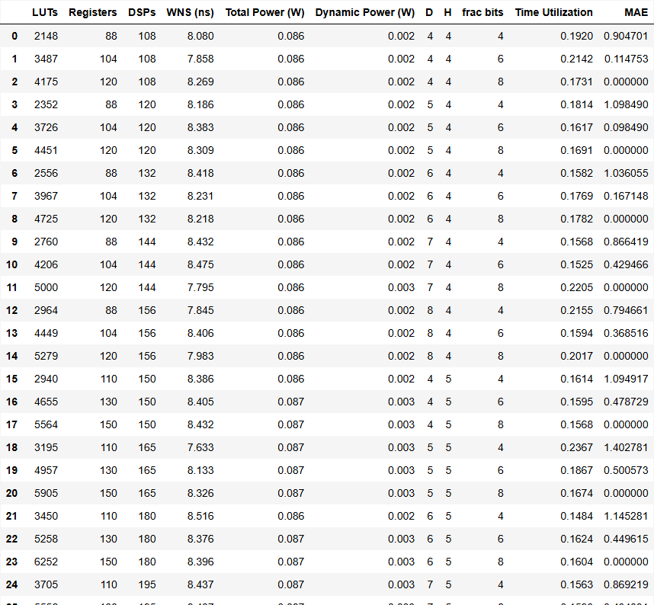
Data Output Analysis

Slide 9
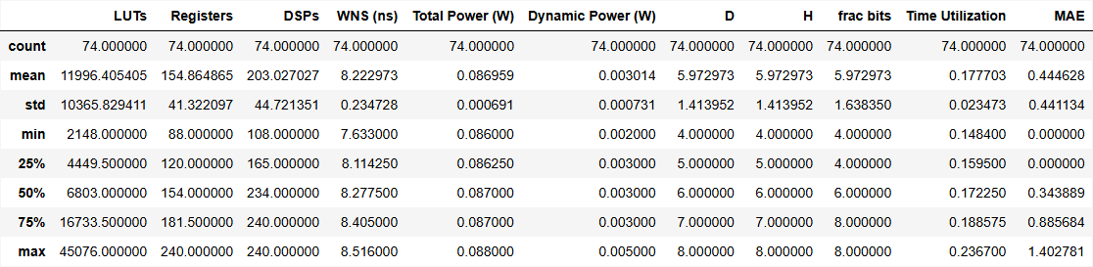
Data Output Analysis

Slide 10
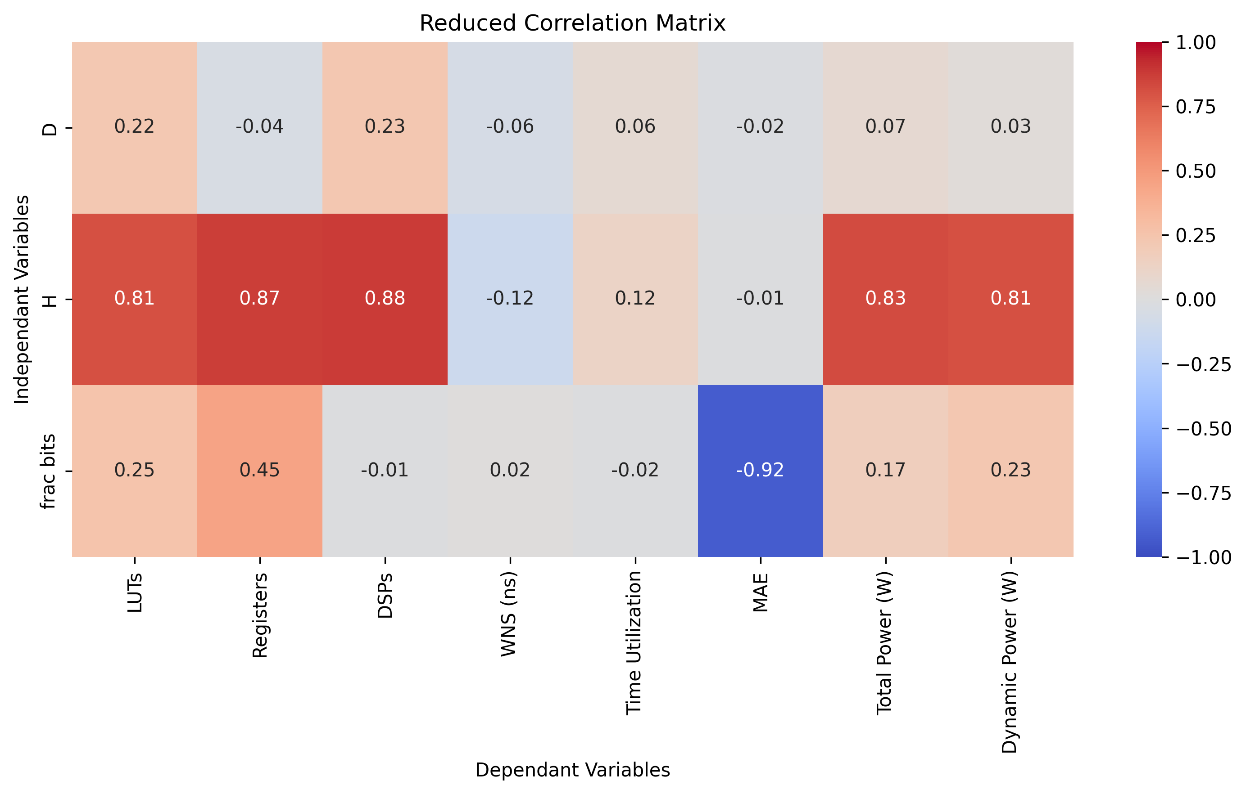
Data Output Analysis

Slide 11
Future Work
In chronological order:
Prepare thesis proposal and deliver a defense of it.
Fix the accuracy bug in the prototype.
Rerun experiment with a larger action space and conduct further analysis on experiment results.
Write and submit a conference manuscript for The Annual International Conference of the IEEE Engineering in Medicine and Biology Society.
Implement a hardware-specific optimization and evaluate it compared to the baseline implementation.

